Slide 1
Introduction to Software Engineering and SaaS

Slide 2
What Makes a Great Software Engineer?
Always improving
Passionate
Technically open-minded
Data-driven
Elegant solutions
Creative thinking when faced with limitations of current solutions
Anticipates technical needs based on prior experience
Personal Characteristics
Technical Skills
Knows people & organization
Updates mental models when learn new skills/facts/context
Consider situation at multiple levels when making judgments
Can reason about complex & intertwining ideas
Helps others understand by tailoring explanations to them
Creates shared success possibly via personal compromises
Creates “safe haven” where others can learn from mistakes
Gives honest feedback
Decision Making
Team Skills

Slide 3
Online Resources
http://www.saasbook.info/students
Online "get started" tutorials on ruby in case want to get feet wet before Ruby lectures
Pointers to online HTML/CSS tutorials in in case want to get feet wet before Rails material
Tutorials on other tools (GitHub, etc.)

Slide 4
Which aspect of the software lifecycle consumes the most resources?
Design
Development
Testing
Maintenance

Slide 5
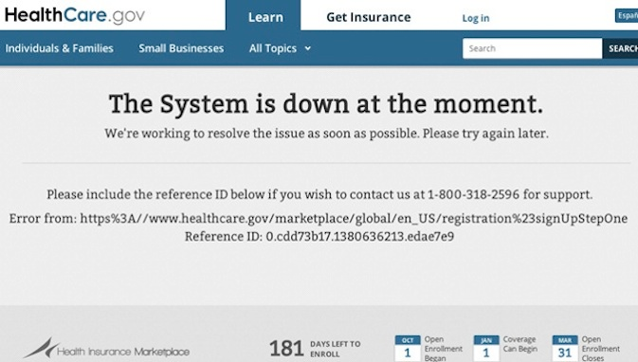
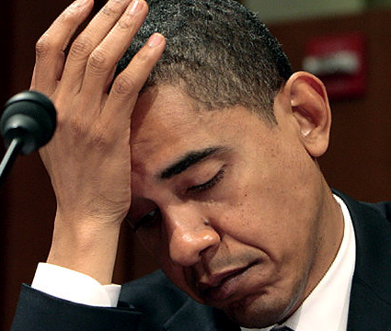
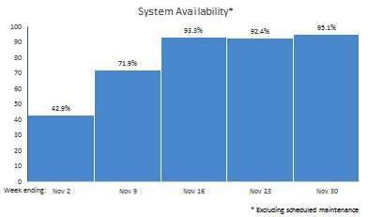
Poor President Obama…
95.1%
42.9%
“HealthCare.gov Progress & Performance Report”, CMS.gov, 12/1/13

Slide 6
How can you avoid infamy?
Lessons from 60 years of SW development
This class will review many approaches in lecture, listing pros and cons
Understand that software engineering is more than just programming

Slide 7
Plan-and-Document processes: Waterfall vs. Spiral vs. RUP
Engineering Long Lasting Software §1.8, §10.7

Slide 8
How to Avoid SW Infamy?
Can't we make building software as predictable in schedule and cost and quality as building a bridge?
If so, what kind of development process to make it predictable?

Slide 9
Software Engineering
Bring engineering discipline to SW
Term coined ~ 20 years after 1st computer
Find SW development methods as predictable in quality, cost, and time as civil engineering
“Plan-and-Document”
Before coding, project manager makes plan
Write detailed documentation all phases of plan
Progress measured against the plan
Changes to project must be reflected in documentation and possibly to plan

Slide 10

1st Development Process: Waterfall (1970)
5 phases of Waterfall “lifecycle”
Requirements analysis & specification
Architectural design
Implementation & Integration
Verification
Operation & Maintenance
Complete one phase before start next one
Why? Earlier catch bug, cheaper it is
Extensive documentation/phase for new people
(Photo by Carola Lauber of SD&M www.sdm.de. Used by permission under CC-BY-SA-3.0.)

Slide 11
How well does Waterfall work?
And the users exclaimed with a laugh and a taunt: “It’s just what we asked for, but not what we want.”
Anonymous
Often when customer sees it, wants changes to SW product

Slide 12
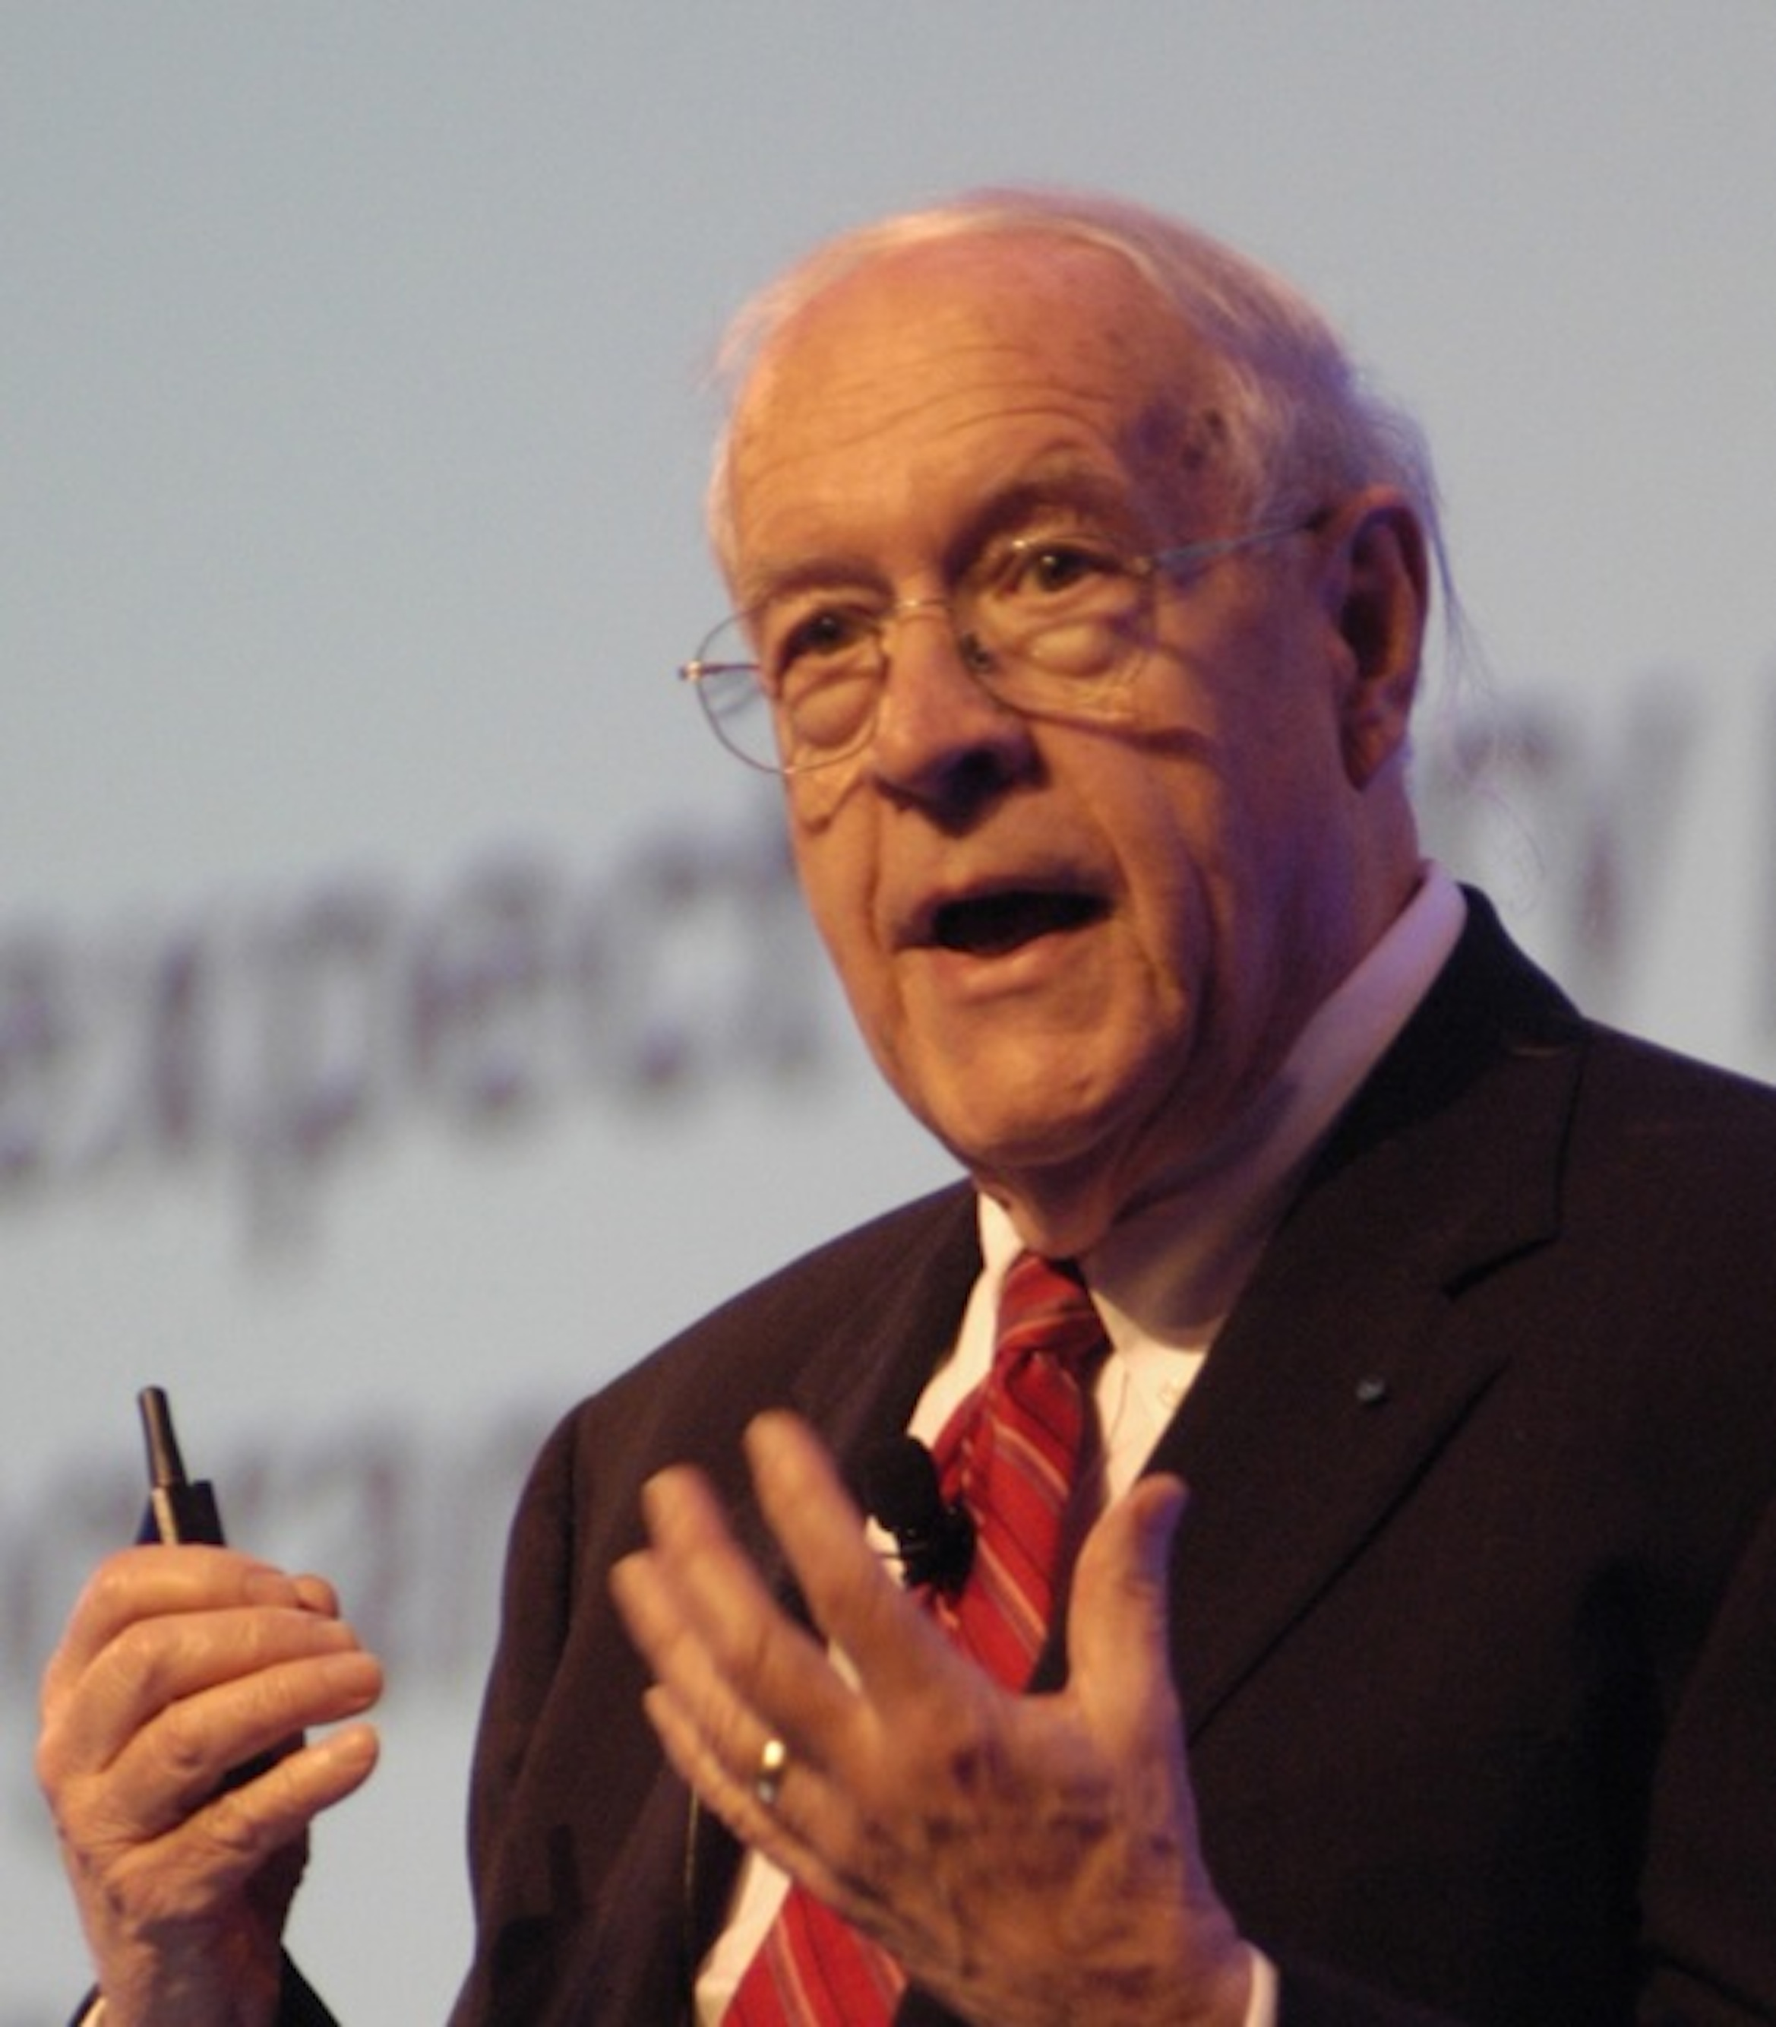
How well does Waterfall work?
“Plan to throw one [implementation] away; you will, anyhow.”
Fred Brooks, Jr. (1999 Turing Award winner)
Often after build first one, developers learn right way they should have built it
(Photo by Carola Lauber of SD&M www.sdm.de. Used by permission under CC-BY-SA-3.0.)
Notes:
May apply to your project
Downside to waterfall?

Slide 13
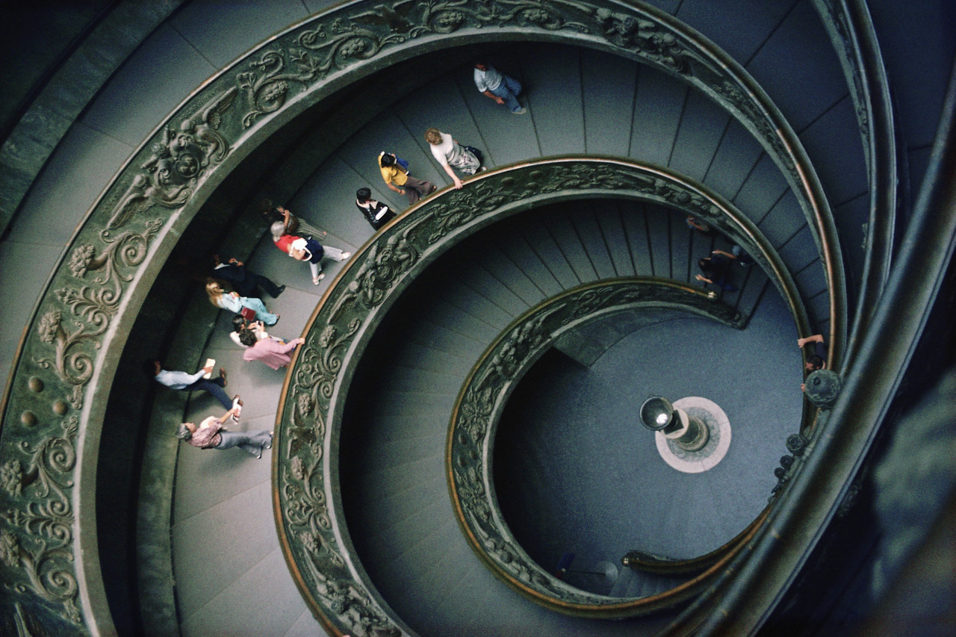
Spiral Lifecycle (1986)
Combine Plan-and-Document with prototypes
Rather than plan and document all requirements first…
develop plan and requirement documents across each iteration of prototype as needed and evolve with the project

Slide 14
Spiral Lifecycle
(Figure 1.4, Engineering Long Lasting Software by Armando Fox and David Patterson, 2nd Beta edition, 2013.)

Slide 15
Spiral - Good and Bad
The Good
The Bad
Iterations involve the customer before the product is completed
Reduces chances of misunderstandings
Risk management part of lifecycle
Project monitoring easy
Schedule & cost more realistic over time
Iterations 6 to 24 months long
time for customers to change their minds!
Lots of documentation per iteration
Lots of rules to follow, hard for whole project
Cost of process is high
Hard to meet budget and schedule targets

Slide 16
Rational Unified Process (RUP) Lifecycle (2003)
Figure 1.5, Engineering Long Lasting Software by Armando Fox and David Patterson, 2nd Beta edition, 2013.

Slide 17
RUP Phases
4 Phases (can iterate)
Inception: business case, set schedule and budget, risk assessment
Elaboration: use cases, SW architecture, prototype
Construction: codes and tests the product, 1st release.
Transition: move to real environment, get customer acceptance

Slide 18
RUP - Good and Bad
the good
The Bad
Business practices tied to development process
Lots of tools from Rational (now IBM)
Tools support gradual improvement of project
Tools are expensive (not open source)
So many options to tailor RUP to a company, so not use all the tools
Only good for medium to large-scale projects
Manager’s call size of iterations to make manageable

Slide 19

Plan and Document (P&D) Project Manager
P&D depends on Project Managers
Write contract to win the project
Recruit development team
Evaluate software engineers performance, which sets salary
Estimate costs, maintain schedule, evaluate risks & overcomes them
Document project management plan
Gets credit for success or blamed if projects are late or over budget

Slide 20
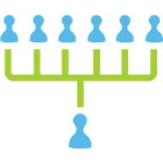
P&D Team Size
“Adding manpower to a late software project makes it later.”
Fred Brooks, Jr., The Mythical Man-Month
It takes time for new people to learn project
Communication time grows with size, leaving less time for work
Groups 4 to 9 people, but hierarchically composed for larger projects

Slide 21
Question: Which statement is FALSE about Waterfall, Spiral, and Rational Unified Process lifecycles?
All rely on careful planning and measure progress against the plan
All rely on thorough documentation
All rely on a manager to be in charge of the project
All use iteration and prototypes

Slide 22
Development processes: Agile
(Engineering Long Lasting Software §1.9)
David Patterson

Slide 23
Alternative Process?
How well can plan-and-document hit the cost, schedule, and quality target?
P&D requires extensive documentation and planning and depends on an experienced manager
Can we build software effectively without careful planning and documentation?
How to avoid “just hacking”?

Slide 24
Agile Manifesto, 2001
“We are uncovering better ways of developing SW by doing it and helping others do it. Through this work we have come to value
Individuals and interactions over processes & tools
Working software over comprehensive documentation
Customer collaboration over contract negotiation
Responding to change over following a plan
That is, while there is value in the items on the right, we value the items on the left more.”

Slide 25
Extreme Programming (XP)
If short iterations are good, make them as short as possible (weeks vs. years)
If simplicity is good, always do the simplest thing that could possibly work
If testing is good, test all the time. Write the test code before you write the code to test.
If code reviews are good, review code continuously, by programming in pairs, taking turns looking over each other's shoulders.

Slide 26
Agile lifecycle
Embraces change as a fact of life: continuous improvement vs. phases
Developers continuously refine working but incomplete prototype until customers happy, with customer feedback on each Iteration
every ~1 to 2 weeks
Agile emphasizes
Test-Driven Development (TDD) to reduce mistakes
User Stories to validate customer requirements
Velocity to measure progress

Slide 27
Agile Then and Now
Controversial in 2001
“… yet another attempt to undermine the discipline of software engineering… nothing more than an attempt to legitimize hacker behavior.” Steven Ratkin, “Manifesto Elicits Cynicism,” IEEE Computer, 2001
Accepted in 2013
2012 study of 66 projects found majority using Agile, even for distributed teams

Slide 28
Question: Which statement is TRUE?
A big difference between Agile and P&D is that Agile does not use requirements
A big difference between Agile and P&D is measuring progress against a plan
You can build SaaS apps using Agile, but not with Plan-and-Document
A big difference between Agile and P&D is building prototypes and interacting with customers during the process
Notes:
VertLeftWhiteCheck1
While Agile does not develop extensive requirements documents as does Waterfall, the interactions with customers lead to the creation of requirements as user stories, as we shall see in Chapter 7
Βεχκ: Παρτ οφ χοπινγ ωιτη χηανγε ισ μακινγ χηανγε ατ αρχηιτεχτυραλ λεϖελ –
Both build working but incomplete prototypes that the customer helps evaluate. The difference is that customers are involved every two weeks in Agile versus up to two years in with Spiral.
The answer is measuring progress against a plan

Slide 29
Fallacies and Pitfalls, and Chapter 1 Summary
Engineering Long Lasting Software §§1.12, 1.13
David Patterson

Slide 30
Fallacies and Pitfalls
Fallacy: The Agile lifecycle is best for software development
Good match for some SW, especially SaaS
But not for NASA, code subject to regulations
Per topic, will practice Agile way to learn but will also see Plan and Document perspective
Note: you will see new lifecycles in response to new opportunities in your career, so expect to learn new ones
Notes:
Fallacy – sounds true, but false
Pitfall – know it might happen, but it happens anyways

Slide 31
Fallacies and Pitfalls
Pitfall: Ignoring the cost of software design
Since ≈0 cost to manufacture software, might believe ≈0 cost to remanufacture the way the customer wants
Ignores the cost of design and test
Is cost ~no cost of manufacturing software/data same rationale to pirate data? No one should pay for development, just for manufacturing?

Slide 32
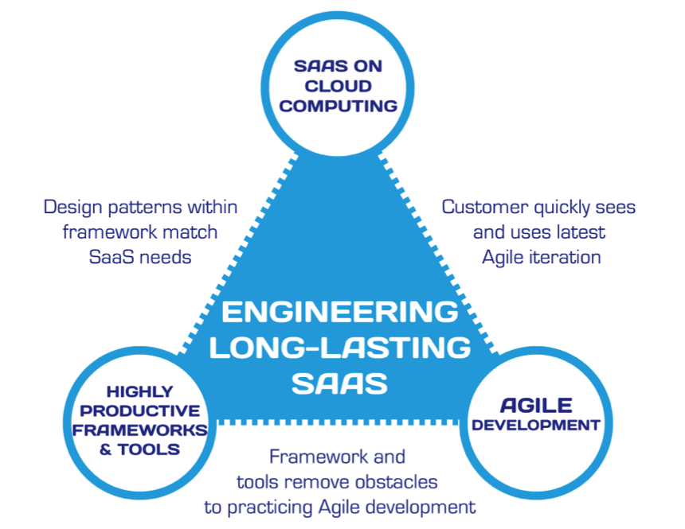
Summary: Engineering SW is More Than Programming
(Figure 1.7, Engineering Long Lasting Software by Armando Fox and David Patterson, Beta edition, 2012.)

Slide 33
Software as a Service (SaaS) and Service-Oriented Architecture (SOA)
Engineering Software as a Service §1.2-1.3
David Patterson

Slide 34


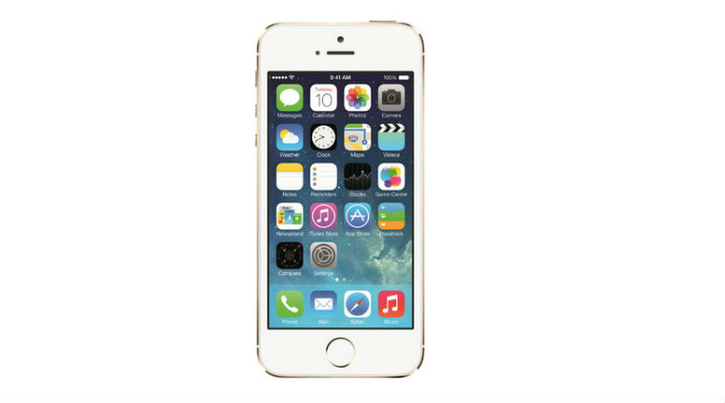

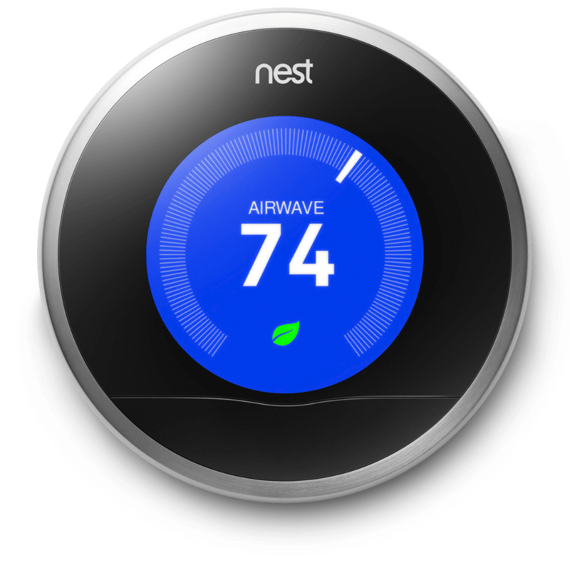

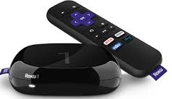
What do they have in common?

Slide 35
Shrink-wrapped software (SWS)
client-specific binary, frequent upgrades
Must work w/many versions of HW, OS, Libraries, …
Hard to maintain
Extensive compatibility testing per release
Alternative: server-centric app, thin client
Search, email, commerce, social nets, video…
Now also productivity (Google Docs/Office 365), finance (TurboTax Online), IDEs (Codenvy)…
Your instructors believe this is future of SW

Slide 36
Why is SaaS better than SWS?
No install worries about HW capability, OS
Data stored safely, persistently on servers
Easy for groups to interact with same data
If data is large or changed frequently, simpler to keep 1 copy at central site
1 copy of SW and single HW/OS environment
no compatibility hassles for developers
beta test new features on 1% of users
simplifies upgrades for developers and no user upgrade requests

Slide 37
Smartphone Native
Pros
Cons
Use HW features unavailable in HTML5
May be faster…or not
Many just HTML5 apps in native "container"
Your brand is on user’s home screen
Though can get this with bookmarks too
Harder to maintain
Upgrades now once again user's problem

Slide 38
Bookstore: Silo
Internal subsystems can share data directly
Review access user profile
All subsystems inside single API
(Figure 1.2, Engineering Software as a Service by Armando Fox and David Patterson, 2nd Beta edition, 2013.)

Slide 39
Bookstore: SOA
Subsystems independent, as if in separate datacenters
Review Service access User Service API
Can recombine to make new service
example: Favorite Books
(Figure 1.3, Engineering Software as a Service by Armando Fox and David Patterson, 2nd Beta edition, 2013.)

Slide 40
Which of the following is a disadvantage of SOA compared to a silo design?
SOA may be harder to debug and tune
SOA results in lower developer productivity
SOA’s complexity is a poor match for small teams
SOA is more expensive to deploy than Silo, because more servers are needed to handle the same workload

Slide 41

Cloud Computing
Engineering Software as a Service §1.4
David Patterson

Slide 42
What is ideal HW for SaaS?
Amazon, Google, Microsoft developed hardware systems to run SaaS
What did they use: Mainframes? Supercomputers?
How can independent SW developers build SaaS apps and compete without similar HW investments to Amazon, Google, Microsoft?

Slide 43
Ideal hardware infrastructure for SaaS?
SaaS's 3 demands on infrastructure
Communication
Allow customers to interact with service
Scalability
Fluctuations in demand
Dependability
Service & communication available 24x7

Slide 44
Services on Clusters
Clusters: Commodity computers connected by commodity Ethernet switches
More scalable than conventional servers
Much cheaper than conventional servers
20X for equivalent vs. largest servers
Dependability via extensive redundancy
Few operators for 1000s servers
Careful selection of identical HW/SW
Virtual Machine Monitors simplify operation

Slide 45
Warehouse Scale Computers
Clusters grew from 1000 servers to 100,000 based on customer demand for SaaS apps
Economies of scale pushed down cost of largest datacenter by factors 3X to 8X
Purchase, house, operate 100K v. 1K computers
Traditional datacenters utilized 10% - 20%
Earn $ offering pay-as-you-go use at less than customer’s costs for as many computers as customer needs

Slide 46
Utility Computing / Public Cloud Computing
Offers computing, storage, communication at pennies per hour
No premium to scale:
1000 computers @ 1 hour = 1 computer @ 1000 hours
Illusion of infinite scalability to cloud user
As many computers as you can afford
Leading examples: Amazon Web Services, Google App Engine, Microsoft Azure
Amazon runs its own e-commerce on AWS!

Slide 47
Which statement is false?
Private datacenters are not shared by multiple companies/competitors
Private datacenters may be the only option for some highly-regulated apps
Private datacenters are inherently more secure than public utility computing
Private datacenters could match the cost of public utility computing if they just used the same type of hardware and software

Slide 48
Legacy SW vs. Beautiful SW and Software Quality
Engineering Software as a Service §1.5-1.6
David Patterson

Slide 49
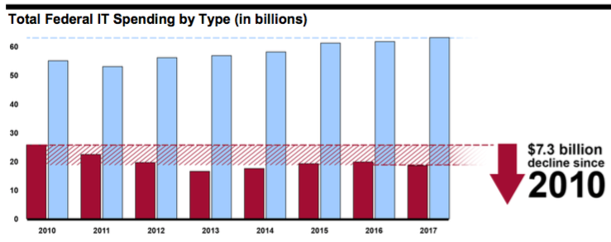
Maintenance vs. Development: Federal IT spending, 2010-2017
Development, modernization, enhancement
Operations & maintenance
Source: Government Accountability Office (GAO) report GAO-16-696T, Federal Agencies Need to Address Aging Legacy Systems, Testimony Before the Committee on Oversight and Government Reform, House of Representatives. Published May 26, 2016.

Slide 50
Legacy SW vs. Beautiful SW
Legacy code: old SW that continues to meet customers' needs, but difficult to evolve due to design inelegance or antiquated technology
60% SW maintenance costs adding new functionality to legacy SW
17% for fixing bugs
Vital but ignored topic in most SWE courses
Contrasts with beautiful code: meets customers' needs and easy to evolve
Notes:
60% SW maintenance
17% fixing bugs
Failure: Unexpectedly short-lived code
Yet Legacy SW is successful SW

Slide 51
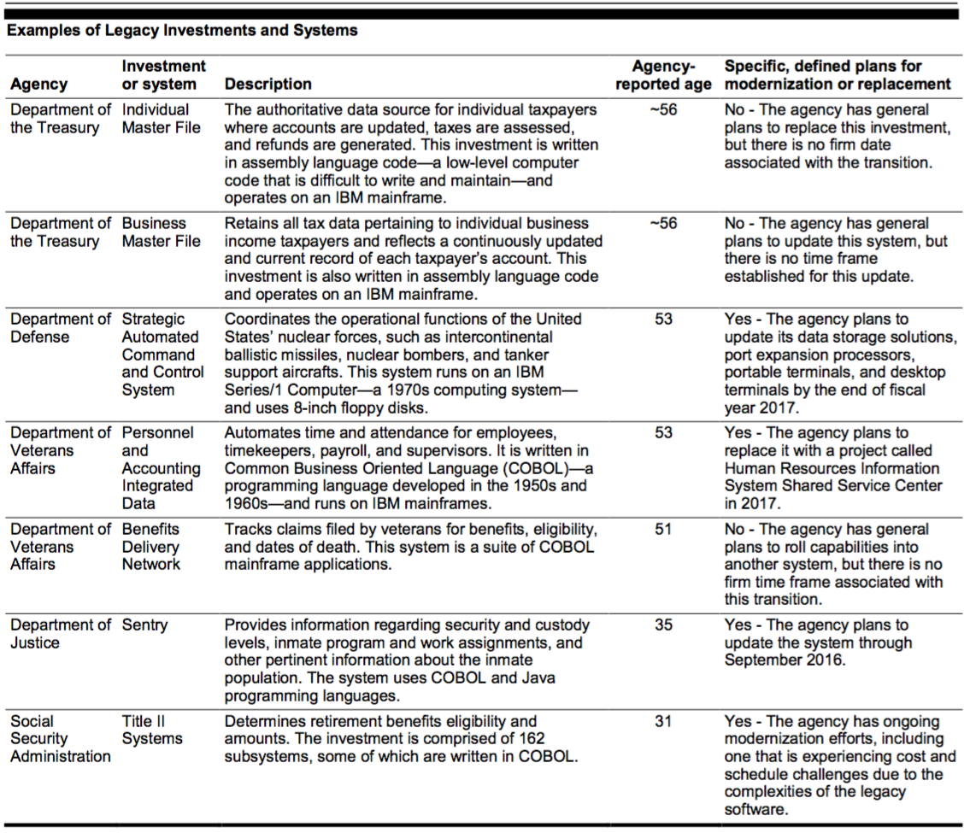
Your Tax Dollars at Work
Source: Government Accountability Office (GAO) report GAO-16-696T

Slide 52
Software Quality
Product quality (in general): "fitness for use"
Business value for customer and manufacturer
Quality Assurance :
processes/standards => high quality products
improve quality
Software quality:
Satisfies customers' needs—easy to use, gets correct answers, does not crash, …
Be easy for developer to debug and enhance
Software QA: ensure quality and improve processes in SW organization

Slide 53
Assurance
Verification: Did you build the thing right?
Did you meet the specification?
Validation: Did you build the right thing?
Is this what the customer wants?
Is the specification correct?
Hardware focus generally Verification
Software focus generally Validation
Testing to Assure Software Quality
Notes:
HW on verification
SW on validation

Slide 54
Exhaustive testing is infeasible
Divide and conquer: perform different tests at different phases of SW development
Upper level doesn't redo tests of lower level
Coverage: various measurements of what % of system is "exercised" by test suite
Unit test: single method does what was expected
Module or functional test: across individual units
Integration test: interfaces between units have consistent assumptions, communicate correctly
System or acceptance test: integrated program meets its specifications

Slide 55
Which statement is NOT true about testing?
Tests that have outlived their usefulness should be discarded
While difficult to achieve, 100% test coverage ensures correct implementation
Higher level tests typically delegate more detailed testing to lower levels
Unit testing works within a single class and module testing works across classes

Slide 56
And in Conclusion: §§1.1-1.7
SaaS less hassle for developers and users
Service Oriented Architecture makes it easy to reuse current code to create new apps
Scale led to savings/CPU => reduced cost of Cloud Computing => Utility Computing
Testing to assure software quality, which means good for customer and developer
Developer Productivity: Conciseness, Synthesis, Reuse, and Tools

Slide 57
Productivity: Conciseness, Synthesis, Reuse, and Tools
Engineering Software as a Service §1.7
David Patterson

Slide 58
Productivity
50 years of Moore’s Law => 2X /1.5 years
HW designs get bigger
Faster processors and bigger memories
SW designs get bigger
Had to improve SW productivity
4 techniques
Clarity via conciseness
Synthesis
Reuse
Automation and Tools

Slide 59
Clarity via conciseness
Syntax: shorter and easier to read
assert_greater_than_or_equal_to(a,7) vs. a.should be ≥ 7
Time.now – 2*60*60 vs. 2.hours.ago
Raise the level of abstraction:
High level programming languages vs. assembly language
Automatic memory management (Java vs. C)
Reflection, metaprogramming
Notes:
a.should be ≥ 7

Slide 60
Reuse vs. write new code
Procedures and functions
Standardized libraries (reuse single task)
Object oriented programming: reuse and manage collections of tasks
Design patterns: reuse a general strategy even if implementation varies

Slide 61
Synthesis: Code that writes code
Commonly used today: templating and code generators (many examples in Rails)
Research Stage: Programming by example
e.g. Excel 2013 Flash Fill

Slide 62
Automation and Tools
Replace tedious manual tasks with automation to save time, improve accuracy
New tool can make lives better (e.g., make)
New tool desiderata: learning curve justifies productivity gained
Good software developer must repeatedly learn how to use new tools: lifetime learning
Lots of chances in this course:Cucumber, RSpec, Pivotal Tracker, …

Slide 63
DRY
"Every piece of knowledge must have a single, unambiguous, authoritative representation within a system."
Andy Hunt and Dave Thomas, 1999
Don't Repeat Yourself (DRY)
vs. apply same repair in many places manually
How: Refactor code to extract commonality

Slide 64
Agile proponents claim that Agile can result in higher productivity because
Test-driven development results in more thorough tests and bugs being found faster
Less time is spent in project meetings because Agile is a more lightweight process
The tools used in Agile tend to operate at a higher level of abstraction than P&D's tools
Constant customer feedback means less time is potentially lost implementing features customer didn't want

